Slide 1
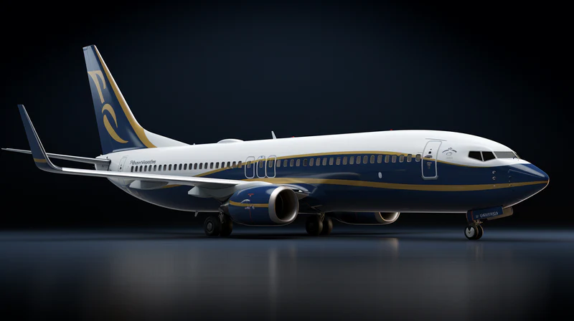

Project Title: Analyzing Trends in Flight Prices
Group 14
Vinay Mattapalli (11636059)
Keerthi Yeakambaram (11805152)
Nehemiah Ray (11836540)
ADTA 5130 Section 001 – Data Analytics I
Instructor: Dr.Henrique Ewbank Ph.D.

Slide 2
Introduction
Dataset Overview:
10,000 flight records
Variables: Airlines, airports, distance, flight duration, class, ticket price, booking behavior.
Objective:
Identify factors influencing flight pricing
Provide actionable insights for airlines
Tools Used: Excel for statistical calculations and visualizations.

Slide 3
EXPLORATORY DATA ANALYSIS
Focus Areas:
Flight duration, distance, booking behavior, ticket class
Key Findings:
Higher frequencies on specific days
First Class showed unexpected dominance due to promotions
Longer flights and advance bookings tend to affect prices.

Slide 4
Descriptive Statistics
Summary of key metrics:
Distance: Avg 4002 miles; max 8000 miles
Flight Duration: Avg 8 hours; max 15 hours
Advance Booking Days: Avg 182 days; max 364 days
Flight Price: Avg $1026; max ~$2000

Slide 5
Hypotheses Testing
Hypotheses Analyzed:
Southwest vs. Delta prices (higher for Southwest)
Longer flights cost more
Early bookings lead to higher costs
British Airways: Economy more expensive than First Class

Slide 6

ANOVA Results
Flight Price vs. Booking Days:
F-statistic > F-critical; p-value = 0
Advanced bookings show significant price influence.
Flight Price vs. Duration:
F-statistic > F-critical; p-value = 0
Longer flights correlate with higher prices.

Slide 7

Regression Analysis
Distance:
R² = 0; distance not predictive of prices.
Duration:
R² = 0; limited influence on prices.
Advance Booking:
R² = 0; no strong link to price variation.

Slide 8
Conclusion
Key Insights:
Early bookings reduce costs.
Duration has limited price influence in the data.
Suggests unmeasured factors (e.g., seasonality, demand).
Recommendations:
Airlines should optimize strategies considering more variables.
Future studies: Include external factors for robust pricing models.

Slide 9
THANK YOU

